Slide 1



Introduction to R
MSc. Kian Jenab
PhD student
Devision of Terrestrial Ecosystem Research
Centre for Microbiology and Environmental Systems Science
University of Vienna
Email: kian.jenab@univie.ac.at

Slide 2
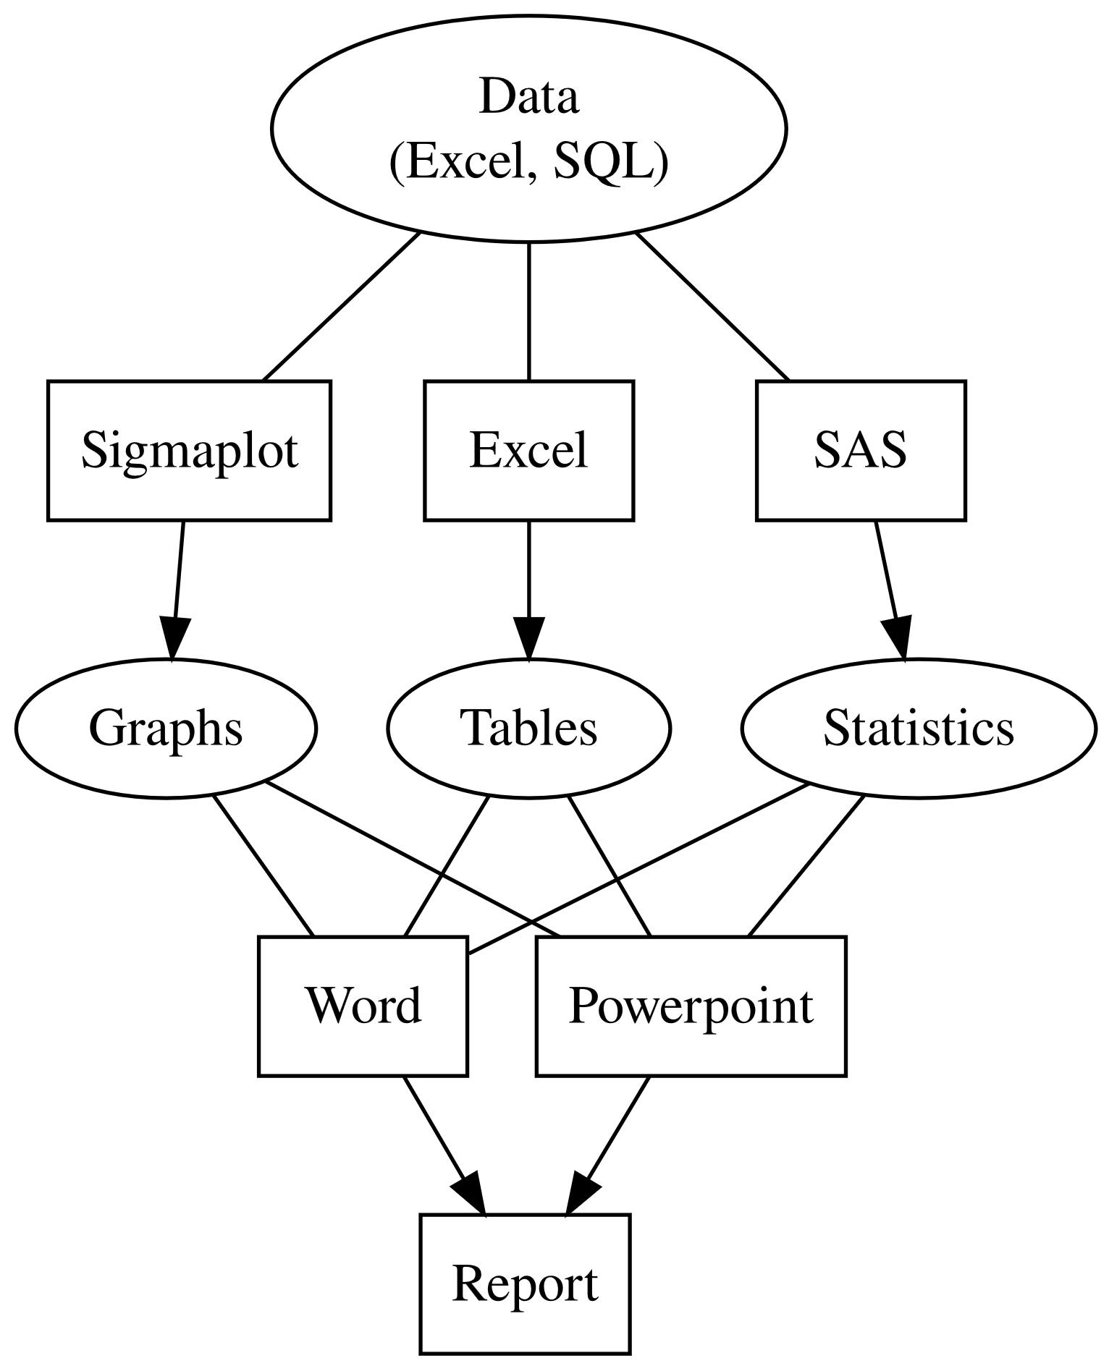
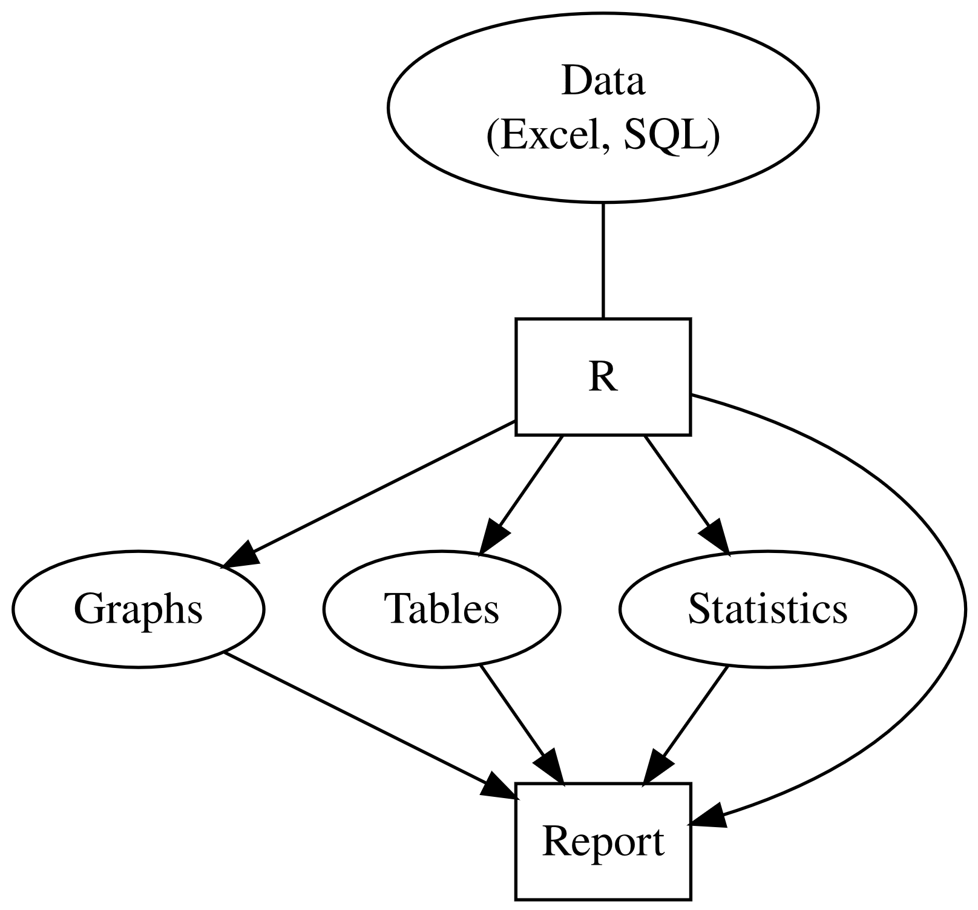
R is a free an open-source programming language.
Ross Ihaka and Robert Gentleman (University of Auckland,1993)
More and more scientists use it every year!
wwww.r.qcbs.ca
wwww.r.qcbs.ca

Slide 3
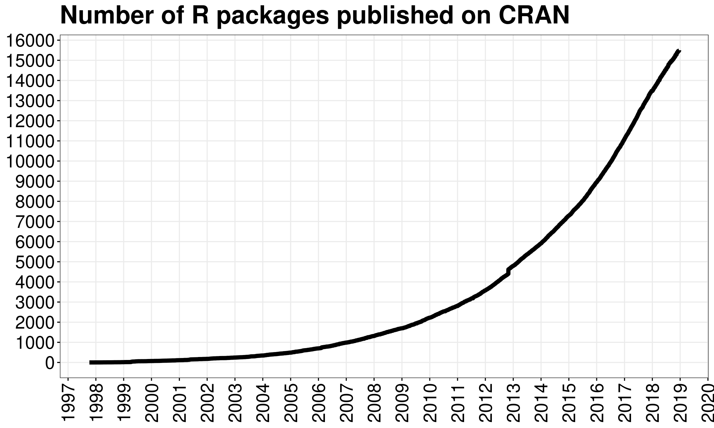
sweet side
Free and open source
Big community of statisticians developing up to date functions
Flexible and fast
Available for Windows/Linux/OSX
Based on scripts
Takes a bit to get into it, but
Scripts are repeatable and can be reviewed

Slide 4
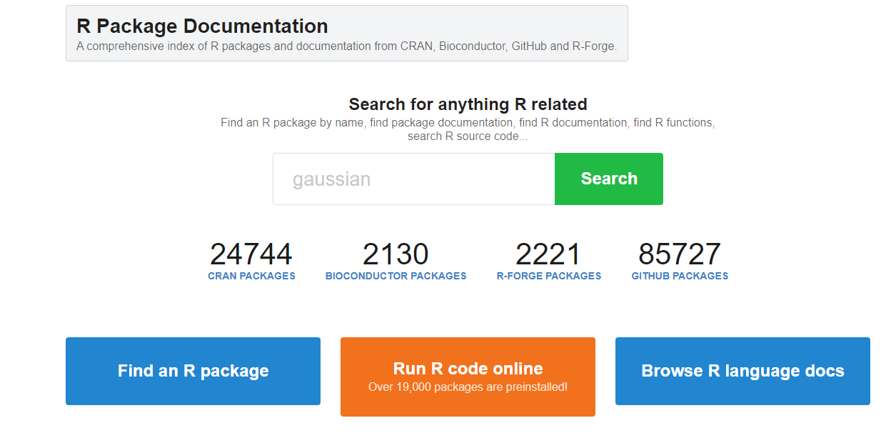
https://rdrr.io
Visited on 12.09.2023

Slide 5
Dark side
Free and open source
Notation is not consistent
Lots of different ways
Sometimes hard to find suitable functions

Slide 6

Rstudio
RStudio is the most used Integrated Development Environment (IDE) for R.
Really makes life easier!
Other IDE for R: Atom, Visual Studio, Jupyter notebook and Jupyter lab!

Slide 7
R Windows
Console window
you can enter commands directly
This is where all the magic happens
Script window
you can write commands and start them
(with control/cmd+enter)
for repeating, evaluations and debugging
Graphical window
Under OSX called quartz device

Slide 8
Types of R classes
Numeric (numbers, 7, 2.3, 4.5e2=450, 4.5e-2=0.045)
Integer: Discontinuous numbers (1,5,12,18,….)
Character (text, always under "")
Logical (TRUE(=T,=1)/FALSE(=F,=0))
Factor (categorical)

Slide 9
Types of R datasets
Vector (one dimensional, all values are of the same type)
Matrix (two dimensional, all values are of the same type)
Array (two dimensional, all values are of the same type, More than one matrix)
Data frame (like a matrix, but values don't need to be of the same type, and the columns have names)
List (the most general concept, can contain everything:vector,matrix,data frame, array)

Slide 10
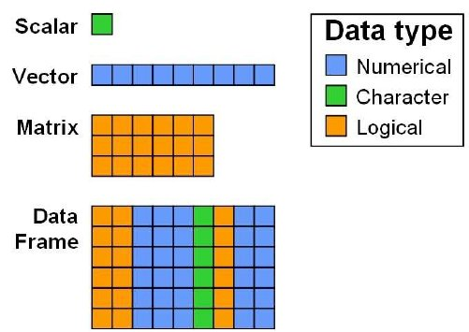
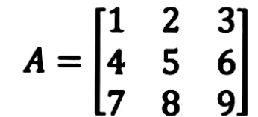
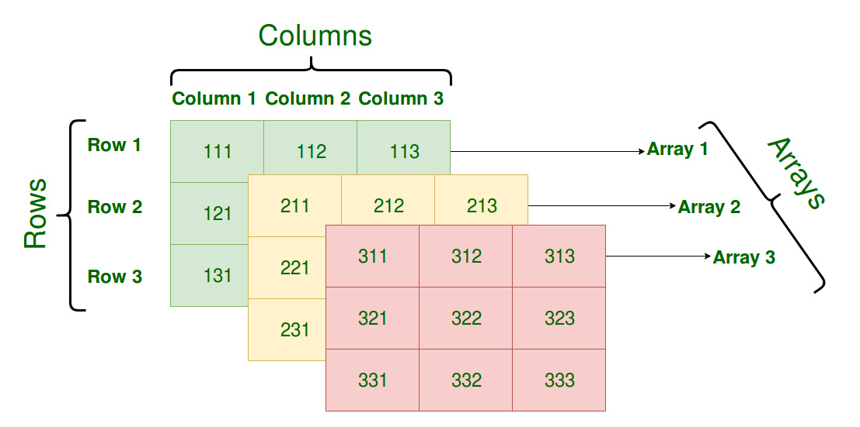
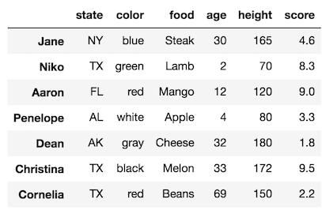
Matrix
Array
Data Frame

Slide 11
Let’s go to Rstudio!

